Slide 1
UNIT 1 & 2
UNIT 1: Introduction to Java [2 hrs]
UNIT 2: Tokens, Expressions and Control Structures [5 hrs]

Slide 2
Introduction to Java
Java is an object-oriented, cross-platform programming language introduced in 1995 by Sun Microsystems.
It is a general purpose programming language intended to let application developers write once, run anywhere, meaning that compiled Java code can run on all platforms that support Java without the need for recompilation
It supports the following fundamental concepts (Polymorphism, Inheritance, Encapsulation, Abstraction, Classes, Objects, Instance, Method, Message Parsing).
It is owned by Oracle, and more than 3 billion devices run Java.
It is used for:
Mobile applications (specially Android apps)
Desktop applications
Web applications
Web servers and application servers
Games
Database connection
And much, much more!

Slide 3
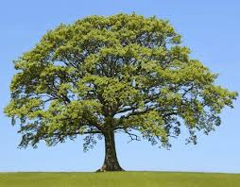
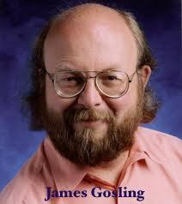
History of Java
James Gosling, Mike Sheridan, and Patrick Naughton initiated the Java language project in June 1991. The small team of sun engineers called Green Team.
Originally designed for small, embedded systems in electronic appliances like set-top boxes.
Firstly, it was called "Greentalk" by James Gosling, and file extension was .gt.
After that, it was called Oak and was developed as a part of the Green project.
Why Oak? Oak is a symbol of strength and chosen as a national tree of many countries like U.S.A., France, Germany, Romania, etc.
In 1995, Oak was renamed as "Java" because it was already a trademark by Oak Technologies.
Initially developed by James Gosling at Sun Microsystems (which is now a subsidiary of Oracle Corporation) and released in 1995.
In 1995, Time magazine called Java one of the Ten Best Products of 1995.
JDK 1.0 released in(January 23, 1996).

Slide 4
Characteristics of Java
Simple
syntax similar to C/C++
Confusing features such as pointers, operator overloading are removed from java
Object Oriented
Everything in java is an object
Java Supports OOP Features such as Inheritance, Polymorphism, Encapsulation, Abstraction etc.
Distributed
Remote Method Invocation (RMI) and Enterprise Java Beans (EJB) are used for creating distributed applications.
We may access files by calling the methods from any machine on the internet.
Robust
Robust means Strong. Java uses strong memory management.
Features such as Garbage collection, exception handling, type checking etc. makes java strong.
Secure
Security is the major concern since java is meant to be used in networked environments.
Access levels such as private, protected, public & default.

Slide 5
6. Architectural Neutral
Byte codes are Platform Independent because it can run on multiple platforms.
Portable
Write once, run anywhere is the concept of portability.
We can carry java byte code to any platform and execute there.
Compiled and Interpreted
Usually a computer language is either compiled or interpreted. Java combines both and so its called two-stage system.
Java compiler translates source code into byte code
Java Interpreter translates byte code to machine code
High Performance
Java is faster than traditional languages.
The performance is due to JIT (just in Time) compilation that cache the recurring process to speed up the process.
10. Multithreaded
The main advantage is that it shares the same memory.
Threads are important for multi-media, web applications etc.

Slide 6
Java Architecture
Java Architecture is a collection of components, i.e., JVM, JRE, and JDK.
It integrates the process of interpretation and compilation. It defines all the processes involved in creating a Java program. Java Architecture explains each and every step of how
Java Architecture can be explained by using the following steps:
There is a process of compilation and interpretation in Java.
Java compiler converts the Java code into byte code.
After that, the JVM converts the byte code into machine code.
The machine code is then executed by the machine.
a program is compiled and executed.

Slide 7
Components of Java Architecture
The Java architecture includes the three main components:
Java Virtual Machine (JVM)
Java Runtime Environment (JRE)
Java Development Kit (JDK)

Slide 8
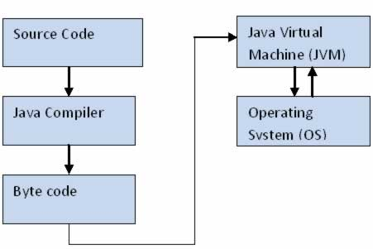
Java Virtual Machine (JVM)
The JVM manages system memory and provides a portable execution environment for Java-based applications
The JVM has two primary functions: to allow Java programs to run on any device or operating system (known as the "Write once, run anywhere" principle), and to manage and optimize program memory.
It converts Java byte code into machines language. JVM is a part of JRE(Java Run Environment).
The JVM manages memory through a process called garbage collection, which continuously identifies and eliminates unused memory in Java programs. Garbage collection happens inside a running JVM.

Slide 9
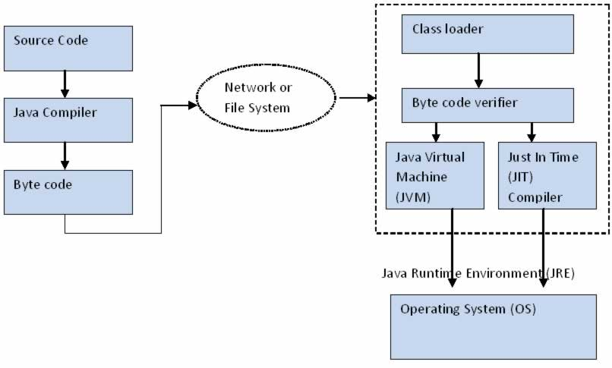
Java Architecture / Working of JVM / How Java Works?

Slide 10
Java source code (.java files) is compiled into byte code by java compiler.
Byte code is not executable code for the target machine; rather it’s a object code for JVM. Byte code will be stored in class files (.class).
During run time, this byte code will be loaded, verified and JVM interprets the byte code into machine code which will be executed in the machine in which the java program runs.
Class loader loads all the class files required to execute the program. Class loader makes the program secure by separating the namespace for the classes obtained through the network from the classes available locally.
Next step is Byte code verification by byte code verifier. It checks the byte code and ensure the following:
The Code follows JVM Specifications
There is no unauthorized access to memory
The code doesn’t cause any stack overflows
There is no illegal data conversions in the code such as float to object references.
Once the code is verified, and proven that there is no security issue with code, JVM will convert the byte code into machine code .
Just in Time (JIT) Compiler is a component that helps the program execution to happen faster. Code is cached by JIT Compiler and will be reused for the future needs.

Slide 11
Java Development Kit (JDK)
It is a software development environment used for developing Java applications and applets.
It includes the Java Runtime Environment (JRE), an interpreter/loader (java), a compiler (javac), an archiver (jar), a documentation generator (javadoc) and other tools needed in Java development.
It is a superset of a JRE and contains tools for Java programmers, e.g. a javac compiler. The Java Development Kit is provided free of charge either by Oracle Corporation directly, or by the OpenJDK open source project, which is governed by Oracle.

Slide 12
Java Runtime Environment (JRE)
The Java Runtime Environment (JRE), also known as Java Runtime, is part of the Java Development Kit (JDK), a set of programming tools for developing Java applications.
The Java Runtime Environment provides the minimum requirements for executing a Java application.
it consists of the Java Virtual Machine (JVM), core classes, and supporting files.
It is a software package that contains what is required to run a Java program.
It includes a Java Virtual Machine implementation together with an implementation of the Java Class Library.

Slide 13
OOP vs. POP
OOP | POP
OOP takes a bottom-up approach in designing a program. | POP follows a top-down approach.
Program is divided into objects depending on the problem. | Program is divided into small chunks based on the functions.
Each object controls its own data. | Each function contains different data.
Focuses on security of the data irrespective of the algorithm. | Follows a systematic approach to solve the problem.
The main priority is data rather than functions in a program. | Functions are more important than data in a program.
The functions of the objects are linked via message passing. | Different parts of a program are interconnected via parameter passing.
Data hiding is possible in OOP. | No easy way for data hiding.
Inheritance is allowed in OOP. | No such concept of inheritance in POP.
Operator overloading is allowed. | Operator overloading is not allowed.
C++, Java. | Pascal, Fortran.

Slide 14
Simple Java Program (HelloWorld.java)
public class HelloWorld {
public static void main(String[] args) {
System.out.println("Hello, World");
}
}

Slide 15
public: So that JVM can execute the method from anywhere.
static: Main method is to be called without object.
The modifiers public and static can be written in either order.
void: The main method doesn't return anything.
main(): Name configured in the JVM.
String[]: The main method accepts a single argument: an array of elements of type String.

Slide 16
Java Garbage Collection
In java, garbage means unreferenced objects.
Garbage Collection is process of reclaiming the runtime unused memory automatically. In other words, it is a way to destroy the unused objects.
To do so, we were using free() function in C language and delete() in C++. But, in java it is performed automatically. So, java provides better memory management.
Advantage of Garbage Collection
It makes java memory efficient because garbage collector removes the unreferenced objects from heap memory.
It is automatically done by the garbage collector(a part of JVM) so we don't need to make extra efforts.

Slide 17
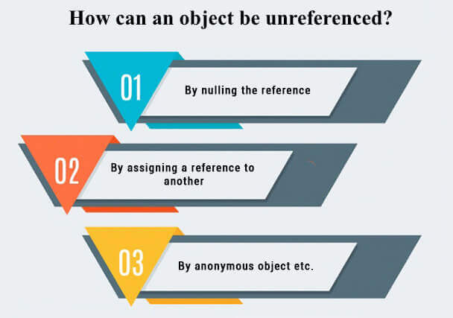
1. By nulling a reference:
Employee e=new Employee();
e=null;
2. By assigning a reference to another:
Employee e1=new Employee();
Employee e2=new Employee();
e1=e2;
//now the first object referred by e1 is available for garbage collection
3. By anonymous object:
new Employee();

Slide 18
Data types in Java
Data types specify the different sizes and values that can be stored in the variable. There are two types of data types in Java:
Primitive data types: The primitive data types include boolean, char, byte, short, int, long, float and double.
Non-primitive data types: The non-primitive data types include Classes, Interfaces, and Arrays.
Data Type | Default Value | Default size
boolean | false | 1 bit
char | '\u0000' | 2 byte
byte | 0 | 1 byte
short | 0 | 2 byte
int | 0 | 4 byte
long | 0L | 8 byte
float | 0.0f | 4 byte
double | 0.0d | 8 byte
Why char uses 2 byte in java and what is \u0000 ?
It is because java uses Unicode system not ASCII code system. The \u0000 is the lowest range of Unicode system.

Slide 19
Identifiers
Identifiers in Java are symbolic names used for identification. They can be a class name, variable name, method name, package name, constant name, and more.
For every identifier there are some conventions that should be used before declaring them.
Rules for defining an Identifier
Identifiers are Case Sensitive
Identifiers can only contain alphanumeric characters [a-z] [A-Z] [0-9] , dollar sign ($) and underscore ( _ ). Example: abc90, abc
Identifiers cannot start with a numeric value [0-9]. The starting character should be alphabet [A-Z] [a-z], dollar ($) or underscore ( _ ).

Slide 20
Keywords
keywords are also known as reserved words
keywords is predefined which are reserved for compiler.
keywords that cannot to used as Identifiers
Example:int, double, public, static, etc

Slide 21
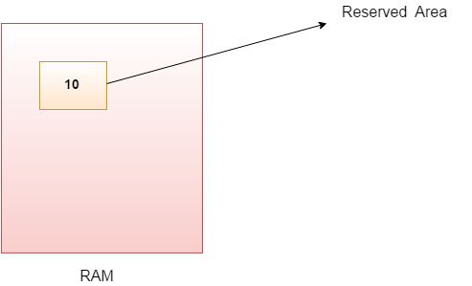
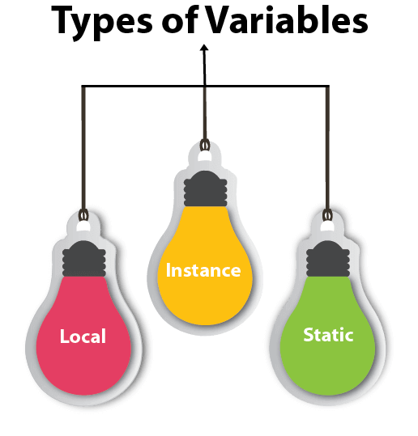
Variables in Java
Variable is name of reserved area allocated in memory. In other words, it is a name of memory location. It is a combination of "vary + able" that means its value can be changed.
int data=50;//Here data is variable

Slide 22
Local Variable
A variable declared inside the body of the method is called Local Variable
You can use this variable only within that method and the other methods in the class aren't even aware that the variable exists.
A local variable cannot be defined with "static" keyword.
Instance Variable
A variable declared inside the class but outside the body of the method is called Instance Variable
It is not declared as static.
Static variable
A variable which is declared as static is called static variable.
It cannot be local.
You can create a single copy of static variable and share among all the instances of the class.
Memory allocation for static variable happens only once when the class is loaded in the memory.
class A{
int data=50;//instance variable
static int m=100;//static variable
void method(){
int n=90;//local variable
}
}//end of class

Slide 23
Operators in Java
Operator in Java is a symbol that is used to perform operations. For example: +, -, *, / etc.
Operator Type | Category | Precedence
Unary | postfix | expr++ expr--
 | prefix | ++expr --expr +expr -expr ~ !
Arithmetic | multiplicative | * / %
 | additive | + -
Shift | shift | << >> >>>
Relational | comparison | < > <= >= instanceof
 | equality | == !=
Bitwise | bitwise AND | &
 | bitwise exclusive OR | ^
 | bitwise inclusive OR | |
Logical | logical AND | &&
 | logical OR | ||
Ternary | ternary | ? :
Assignment | assignment | = += -= *= /= %= &= ^= |= <<= >>= >>>=

Slide 24
class OperatorExample{
public static void main(String args[]){
System.out.println(10<<2);
System.out.println(10<<3);
System.out.println(20<<2);
System.out.println(15<<4);
System.out.println(10>>2);
System.out.println(20>>2);
System.out.println(20>>3);
//For positive number, >> and >>> works same
System.out.println(20>>2);
System.out.println(20>>>2);
//For negative number, >>> changes parity bit (MSB) to 0
System.out.println(-20>>2);
System.out.println(-20>>>2);
}
}
10*2^2=10*4=40
10*2^3=10*8=80
20*2^2=20*4=80
15*2^4=15*16=240
10/2^2=10/4=2
20/2^2=20/4=5
20/2^3=20/8=2
5
5
-5
1073741819

Slide 25
Logical && and Bitwise &
The logical && operator doesn't check second condition if first condition is false. It checks second condition only if first one is true.
The bitwise & operator always checks both conditions whether first condition is true or false.
class OperatorExample{
public static void main(String args[]){
int a=10;
int b=5;
int c=20;
System.out.println(a<b&&a++<c);
System.out.println(a);
System.out.println(a<b&a++<c);
System.out.println(a);
}
}
//false && true = false
//10 because second condition is not checked
//false && true = false
//11 because second condition is checked

Slide 26
Control Statement in Java OR Control Flow (Decision Making Statements)
Java compiler executes the code from top to bottom.
The statements in the code are executed according to the order in which they appear.
However, Java provides statements that can be used to control the flow of Java code. Such statements are called control flow statements

Slide 27
Three Types Of Control Flow Statements
Decision Making statements
If/else statements
Conditional Statements (?: Operator/Ternary Operator)
Switch Statements
Loop statements
do while loop
while loop
for loop
for-each loop
Jump statements
break statement
continue statement

Slide 28
Decision Making Statements
the "if" statement is used to evaluate a condition. The control of the program is diverted depending upon the specific condition.
Syntax:
if(condition) {
statement 1; //executes when condition is true
}
else if(condition 2) {
statement 2; //executes when condition 2 is true
}
else{
statement 2; //executes when condition is false
}

Slide 29
Example:
public class Student {
public static void main(String[] args) {
String city = "Delhi";
if(city == "Meerut") {
System.out.println("city is meerut");
}else if (city == "Noida") {
System.out.println("city is noida");
}else if(city == "Agra") {
System.out.println("city is agra");
}else {
System.out.println(city);
}
}
}

Slide 30
Switch Statement
switch statements are similar to if-else-if statements.
The switch statement contains multiple blocks of code called cases and a single case is executed based on the variable which is being switched.
The switch statement is easier to use instead of if-else-if statements.

Slide 31
Syntax:
switch (expression){
case value1:
statement1;
break;
case valueN:
statementN;
break;
default:
default statement;
}
Example:
int num = 2;
switch (num){
case 0:
System.out.println("number is 0");
break;
case 1:
System.out.println("number is 1");
break;
default:

Slide 32
break statement
When a break statement is encountered inside a loop, the loop is immediately terminated and the program control resumes at the next statement following the loop.
The Java break statement is used to break loop or switch statement. It breaks the current flow of the program at specified condition. In case of inner loop, it breaks only inner loop.
Syntax:
jump-statement;
break;

Slide 33
Example:
public class BreakExample {
public static void main(String[] args) {
//using for loop
for(int i=1;i<=10;i++){
if(i==5){
//breaking the loop
break;
}
System.out.println(i);
}
}
}
Output;
1
2
3
4

Slide 34
Java continue statement
Unlike break statement, the continue statement doesn't break the loop, whereas, it skips the specific part of the loop and jumps to the next iteration of the loop immediately.
public class ContinueExample {
public static void main(String[] args) {
//for loop
for(int i=1;i<=10;i++){
if(i==5){
//using continue statement
continue;//it will skip the rest statement
}
System.out.println(i);
} } }
Output:
1
2
3
4
6
7
8
9
10

Slide 35
Loop Statements
In programming, sometimes we need to execute the block of code repeatedly while some condition evaluates to true.
However, loop statements are used to execute the set of instructions in a repeated order.
For Loop:
It enables us to initialize the loop variable, check the condition, and increment/decrement in a single line of code. We use the for loop only when we exactly know the number of times, we want to execute the block of code.
Syntax:
for(initialization, condition, increment/decrement) {
//block of statements
}

Slide 36
public class Calculattion {
public static void main(String[] args) {
// TODO Auto-generated method stub
int sum = 0;
for(int j = 1; j<=10; j++) {
sum = sum + j;
}
System.out.println("The sum of first 10 natural numbers is " + sum);
}
}

Slide 37
While loop
The Java while loop is used to iterate a part of the program repeatedly until the specified Boolean condition is true. As soon as the Boolean condition becomes false, the loop automatically stops.
The while loop is considered as a repeating if statement. If the number of iteration is not fixed, it is recommended to use the while loop.
Syntax:
while (condition){
//code to be executed
I ncrement / decrement statement
}

Slide 38
Example:
public class WhileExample {
public static void main(String[] args) {
int i=1;
while(i<=10){
System.out.println(i);
i++;
}
}
}

Slide 39
do-while loop
The do-while loop is used to iterate a part of the program repeatedly, until the specified condition is true.
If the number of iteration is not fixed and we must have to execute the loop at least once, it is recommended to use a do-while loop.
The do-while loop is called an exit control loop. Therefore, unlike while loop and for loop, the do-while check the condition at the end of loop body. The do-while loop is executed at least once because condition is checked after loop body.
Syntax:
do{
//code to be executed / loop body
//update statement
}while (condition);

Slide 40
Example:
public class DoWhileExample {
public static void main(String[] args) {
int i=1;
do{
System.out.println(i);
i++;
}while(i<=10);
}
}

Slide 41
Java Comments
The Java comments are the statements in a program that are not executed by the compiler and interpreter.
There are three types of comments in Java.
Single Line Comment(//)
Multi Line Comment(/*……..*/)
Documentation Comment(The documentation comments are placed between /** and */.)

Slide 42
Assignment 1
What makes java so popular? Explain .
What is JVM? Explain Java Architecture in details.
What is Object oriented Programming? How is it different from Procedure Oriented Programming.
Explain structure of Java program with an example.
Why is Java both Interpreted and Compiled Language?
What is operator? Explain different types of operators.
Explain different types of control statements used in java.
Explain different types of looping statements used in java.
How while loop is different from do while loop? Explain with an example.
What is Garbage Collection? Why is it needed?

Slide 43
LabSheet 1
A. Write a java program to
1. print your name, roll no and address.
2. print name, roll no and Percentage entered by user.
3. Calculate factorial of a given number
4. Find Fibonacci Series of n numbers
5. Find the largest element in an given array.
6. display a simple calculator that performs (+,-,*and /).

